Slide 1
THE THIRD INTERNATIONAL CONFERENCE ON EMERGING APPLICATIONS OF MATERIAL SCIENCE AND TECHNOLOGY [ICEAMST 2025]
DATA DETOX: A SMART AND VISUAL SYSTEM FOR ANOMALY DETECTION AND INTERACTIVE CLEANING
PAPER ID - 868
Authors: Presented By:-
N .Swathi
S.Fahimuddin Dept. of AI&DS
H .Keerthi AITS,Rajampet
K. Dinesh Reddy
A. Mahammad Sohail
A. Khadeerulla
11/3/2025
1

Slide 2
TABLE OF CONTENTS
Problem Definition
Abstract
Existing Work
Literature Survey
Proposed Work
Modules
Coding
Testing
References
2

Slide 3
PROBLEM DEFINITION
Real world datasets often contain missing values, duplicated entries, inconsistent formats, and unusual outliers which reduce data reliability and affect the performance of machine learning models. Manual or rule-based data cleaning techniques take more time and fail when processing large and high-dimensional datasets. Existing systems usually focus on limited tasks like only cleaning or only profiling but cannot perform all operations in a single automated pipeline. Due to this, organizations face difficulty in preparing clean data before analytics. Therefore, there is a need for a unified, automated, and intelligent system which performs data cleaning, anomaly detection and data profiling together to improve data quality and ensure trustworthy machine learning outcomes.
3

Slide 4
ABSTRACT
This project introduces Data Detox, a smart and visual automated framework for data cleaning and anomaly detection. The system integrates statistical (IQR) and machine learning based (Isolation Forest) methods to detect outliers, along with automated exploratory data analysis for profiling datasets. It allows users to clean, convert, visualize, and analyze data through an interactive Streamlit interface with minimal manual effort. Experimental evaluation shows that Data Detox significantly reduces preprocessing time, improves consistency, and enhances data quality for more accurate machine learning model performance. The proposed system provides a scalable and efficient solution for modern data quality management across various domains.
4

Slide 5
EXISTING WORK
Most of the existing data cleaning systems rely on manual, rule-based or single statistical approaches. These methods are time-consuming, require repeated human intervention, and do not scale well for large or high-dimensional datasets. Current tools generally focus on only one part of the process such as cleaning or profiling, but they do not provide integrated anomaly detection along with visualization on one platform. Because of this, data preprocessing becomes unreliable, inconsistent and lacks automation support for modern machine learning workflows.
Limitations of Existing Systems
Limited Automation
No Integrated Anomaly Detection
Poor Big Data Scalability
High Manual Effort & Time Consumption
5

Slide 6
LITERATURE SURVEY
TITLE | AUTHORS | METHODOLOGY | LIMITATIONS
Data Cleaning: Problems and Current Approaches (2000) | Erhard Rahm & Hong Hai Do | Introduced core data cleaning methods like duplicate detection, format correction, schema matching & rule-based cleaning. Standardized early manual methods used for ensuring dataset quality. | Manual rule-based approaches cannot handle large / heterogeneous datasets and do not automate anomaly discovery.
Anomaly Detection: A Survey (2009) | Varun Chandola et al. | Survey compares statistical, supervised, semi-supervised & clustering based anomaly detection techniques used across multiple application domains. | No unified workflow integration and anomaly detection not directly connected to cleaning automation for end-to-end usage.
6

Slide 7
LITERATURE SURVEY
TITLE | AUTHORS | METHODOLOGY | LIMITATIONS
Outlier Detection for High Dimensional Data | Markus M. Breunig et al. (LOF) | Proposed Local Outlier Factor based density deviation method to detect abnormal data points by comparing localized neighborhood density patterns. | Computationally expensive for large datasets and not suitable for real-time cleaning pipelines.
Isolation Forest (2008) | Fei Tony Liu et al. | Introduced anomaly detection based on random isolation of data points where anomalies need fewer splits, improving speed and accuracy. | Detects anomalies only but does not perform automatic correction or cleaning integration.
7

Slide 8
LITERATURE SURVEY
TITLE | AUTHORS | METHODOLOGY | LIMITATIONS
OpenRefine Data Cleaning Platform (2012) | Google Research | Provides clustering, transformation, data normalization and duplicate removal through UI based cleaning operations. | Manual intervention required, not automated and not optimized for ML anomaly detection pipelines.
YData Profiling (2020) | YData.ai Team | Generates automated EDA summaries including correlation, distributions, type inference and missing values for dataset profiling. | Profiling only. Does not apply automatic cleaning and does not remove or fix anomalies.
8

Slide 9
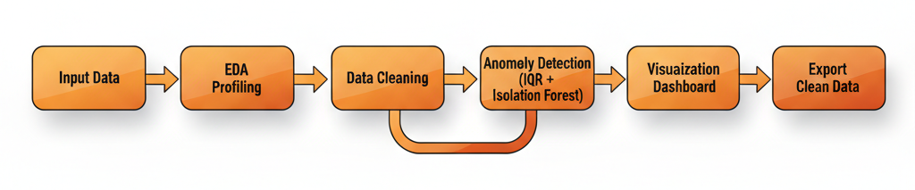
PROPOSED METHODOLOGY
9

Slide 10
MODULES
Data Import Module – Loads raw dataset into system for processing.
Data Profiling (EDA) Module – Generates automated statistical summary, correlations, distributions & quality report.
Data Cleaning Module – Handles missing values, removes duplicates, fixes formatting & standardizes data.
Anomaly Detection Module – Detects abnormal values using IQR & Isolation Forest model techniques.
Visualization Module – Creates interactive plots, charts and insights for better interpretation.
Export Module – Exports cleaned & anomaly-free final dataset for ML model usage.
10

Slide 11
MODULES
Preprocessing Transformation Module – Applies normalization, encoding, type conversions and feature adjustments to prepare uniform dataset structure.
Quality Validation Module – Cross checks data sanity after cleaning to ensure improvement in accuracy, stability and reliability.
Automated Pipeline Execution Module – Runs all cleaning and anomaly detection steps in sequence without manual intervention.
Reporting & Summary Module – Generates final reports showing before vs after cleaning comparison, anomaly count reduction and profiling improvements.
User Interface Module – Allows users to upload, view results, visualize data and export cleaned files through a simple Streamlit based UI.
11

Slide 12
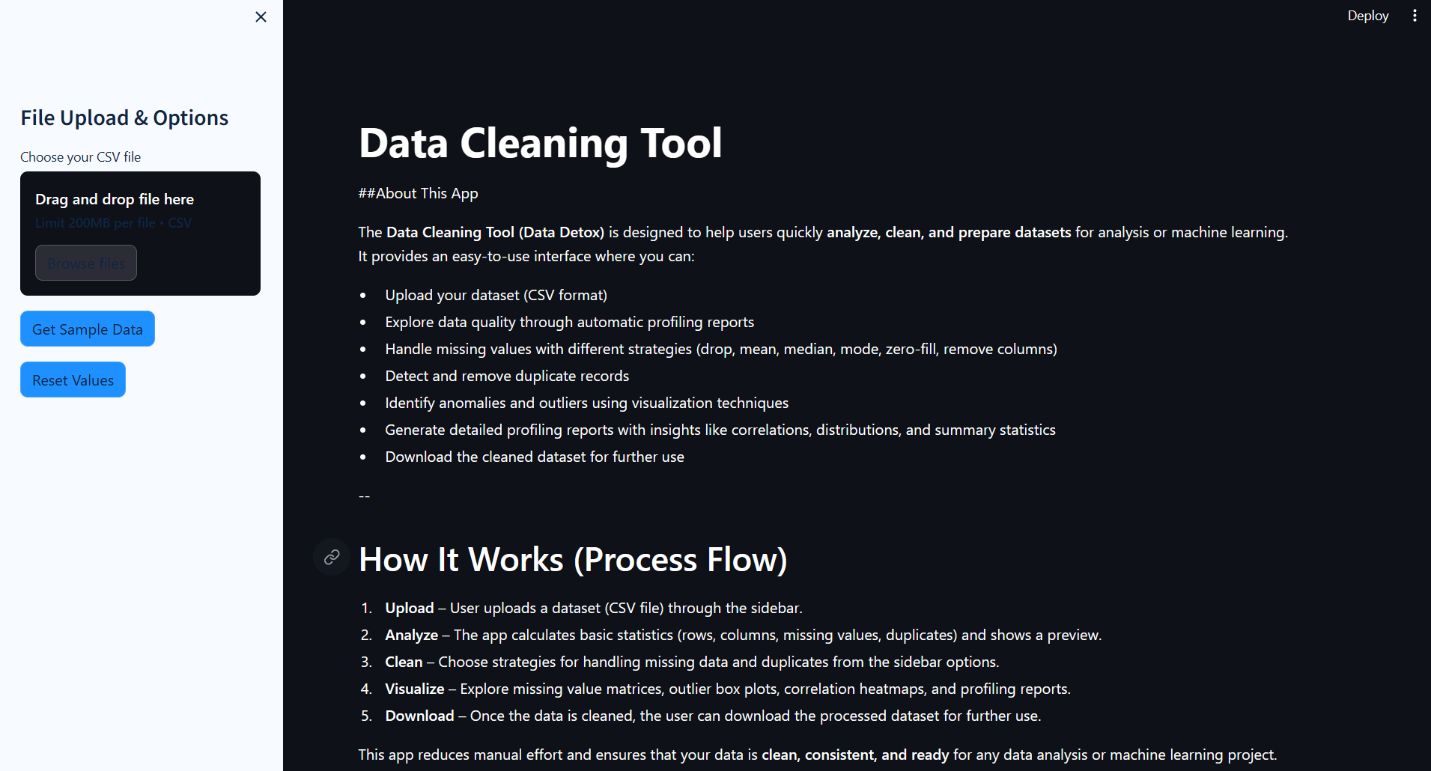
CODING
User Interface
12

Slide 13
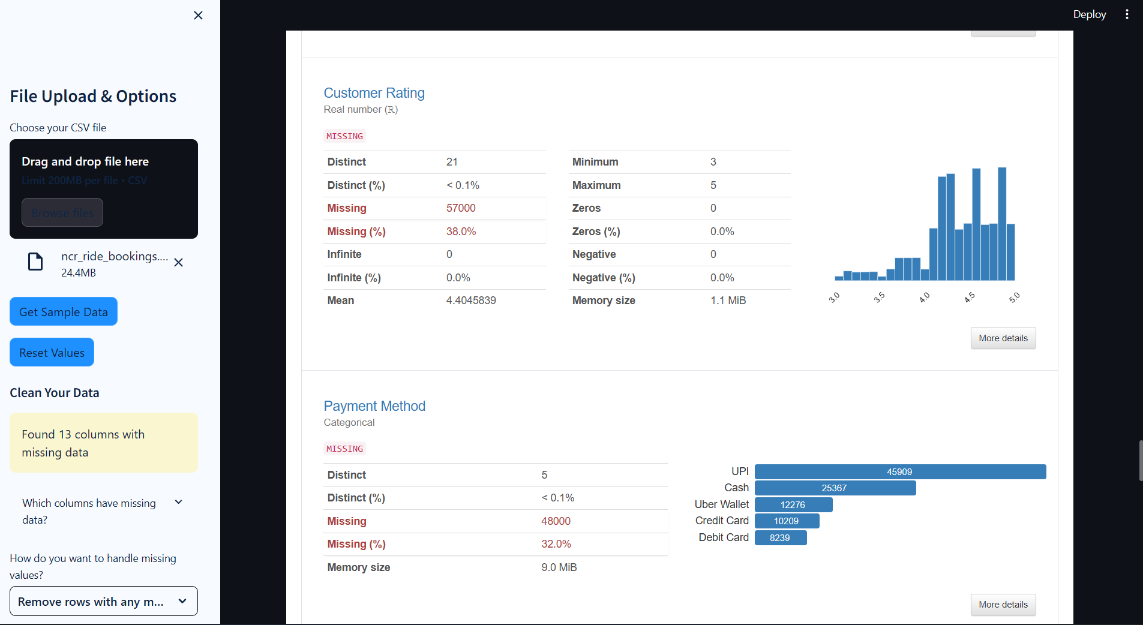
CODING
Profiling Output
13

Slide 14
TESTING
TEST CASE ID | TEST CASE | ACTUAL OUTPUT | PREDICTION | RESULT
1 | Upload dataset with mixed missing values | Missing values detected in multiple columns | System correctly identifies missing % and shows summary | PASS
2 | Apply “Mean” filling strategy on numeric columns | Mean values applied correctly | Dataset transformed without errors | PASS
3 | Remove duplicated rows from dataset | Duplicate rows removed successfully | Duplicate count reduces to zero | PASS
4 | Generate profiling report on cleaned dataset | Valid profiling report generated (stats, graphs, correlations) | No crash, proper insights displayed | PASS
5 | Download cleaned dataset as CSV | CSV generated & downloaded | File preserves cleaned structure | PASS
14

Slide 15
REFERENCES
Juan Fernando Cañola Garcia, et al., “A Deep Learning-Based Intrusion Detection and Preventation System for Detecting and Preventing Denial-of-Service Attacks,” 2019.
Anil Kumar, et al., “RETRACTED: An intrusion prevention and detection approach from the computing perspective,” 2020.
Muhmmad Adil S. Aref, et al., “MapReduce based intelligent model for Intrusion Detection using machine learning techniques,” Springer Journal, 2021.
P. L. S. Jayalaxmi, et al., “Machine and Deep Learning Solutions for Intrusion Detection and Prevention in IoTs: A Survey,” IEEE Access, 2023.
Yasmeen Fatima, et al., “Network Intrusion Detection Using Machine Learning Techniques,” 2023.
M. Tavallaee, E. Bagheri, W. Lu, and A. A. Ghorbani, “A detailed analysis of the KDD CUP 99 data set,” IEEE Symposium on Computational Intelligence for Security and Defense Applications, Jul. 2009, doi: 10.1109/CISDA.2009.5356528.
W. Hu, W. Hu, and S. Maybank, “Adaboost-based algorithm for network intrusion detection,” IEEE Transactions on Systems, Man, and Cybernetics Part B (Cybernetics), vol. 38, no. 2, pp. 577–583, Apr. 2008, doi: 10.1109/TSMCB.2007.912355.
15

Slide 16
THANK YOU
16

